Slide 1
Smart Home
Circuit diagram
1805046 - Al Amru Bil Maruf
1805047 - A.K.M. Ashfaqur Rahman
1805052 - Hasan Masum
1805057 - Md. Jehadul Karim

Slide 2
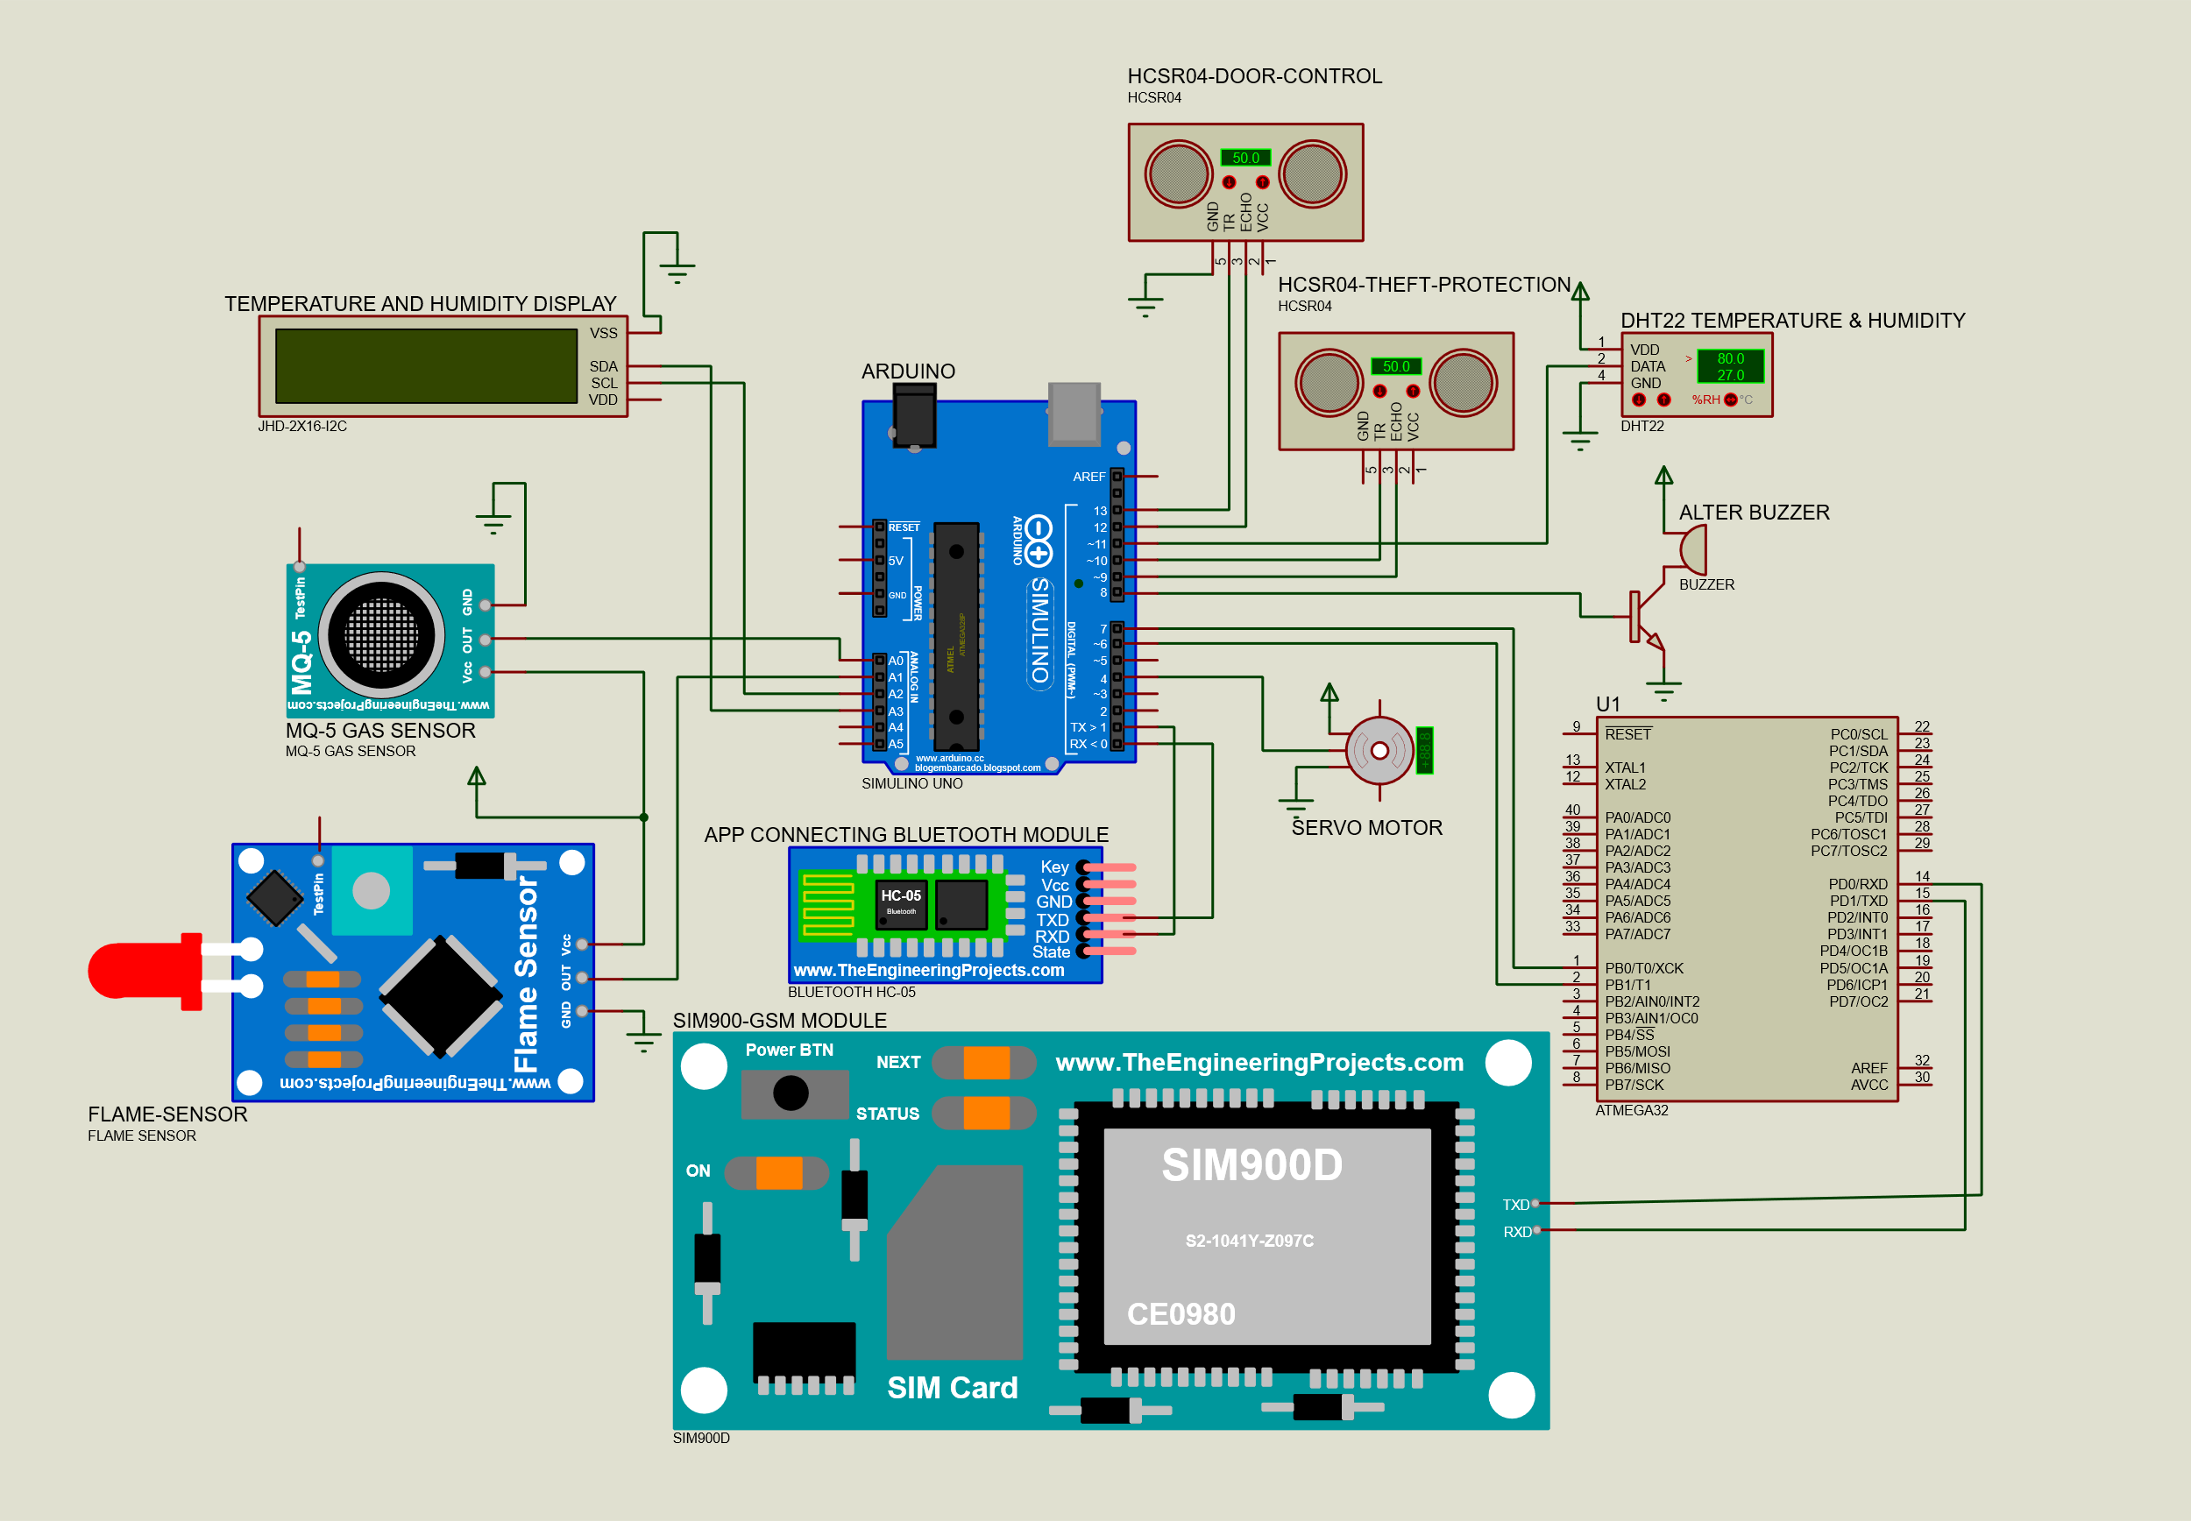
FEATURES

Slide 3
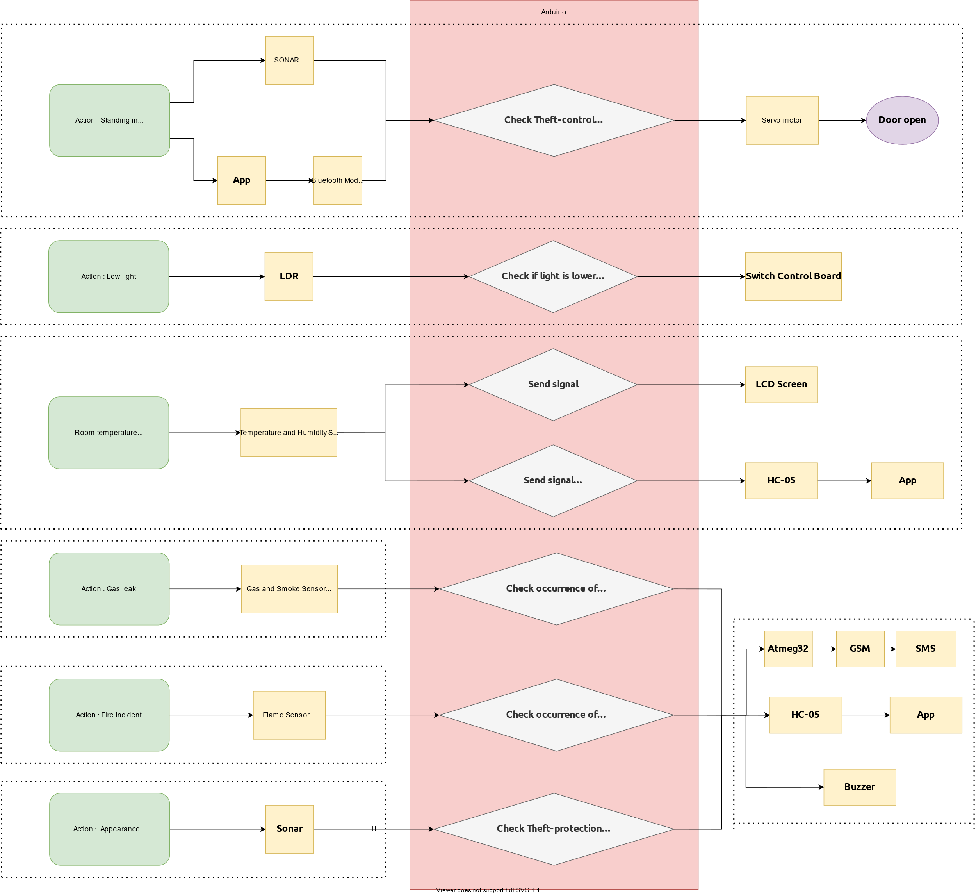
FEATURES

Slide 4

Thank you!

